Slide 1


[Milestone 2]

Slide 2
Question 1. How does neural network extract complex features automatically?
By combining lower level features.
By controlling the lower level feature’s importance via using weights.
By updating weights.
[ gradually by providing nonlinearity ]
[ Consequently, layer by layer NN can extract more and more complex features ]

Slide 3
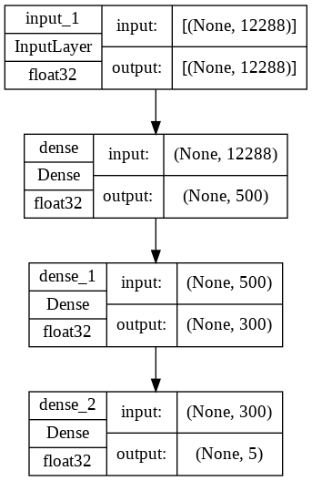

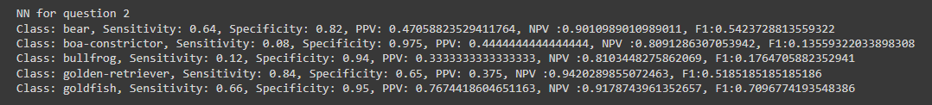
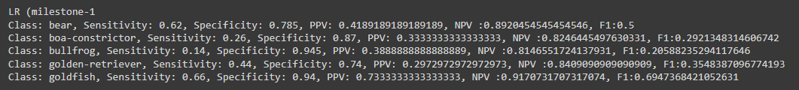
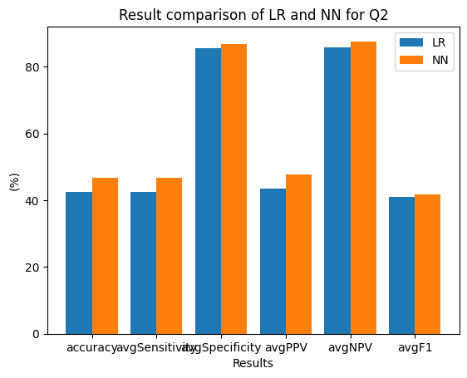
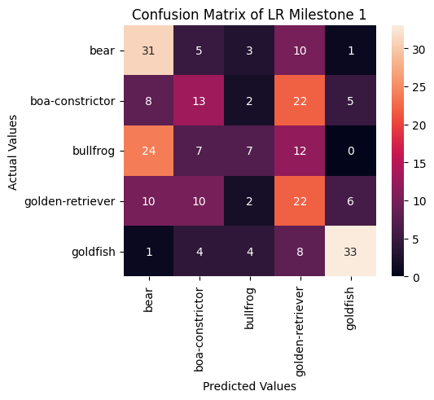
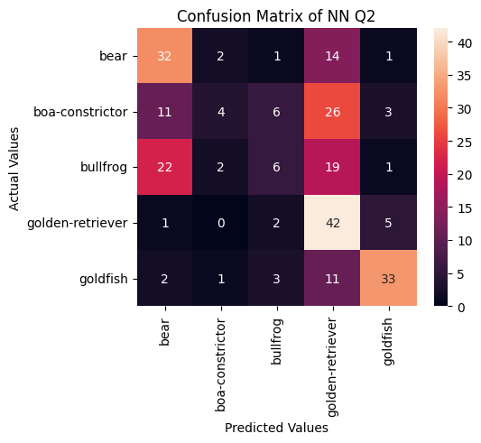
Question 2: Comparing the results of NN with that of the Logistic Regression model for Milestone 1.

Slide 4
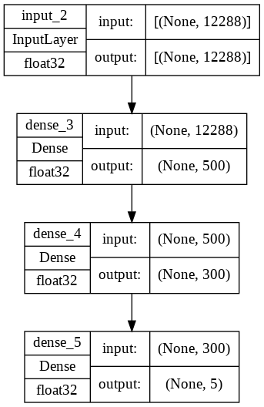
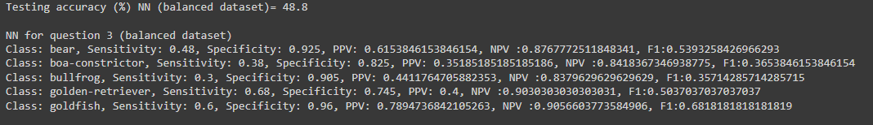
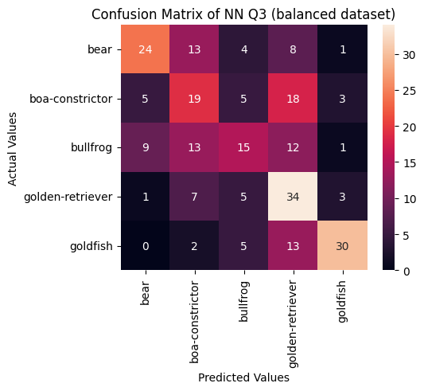
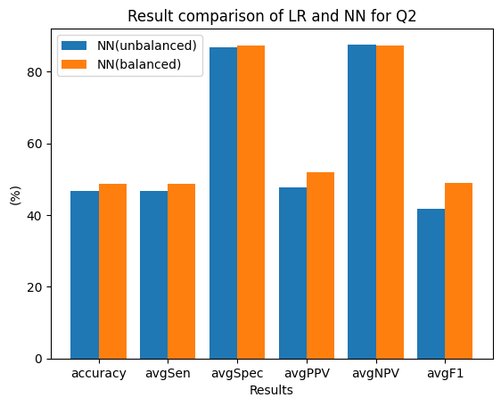
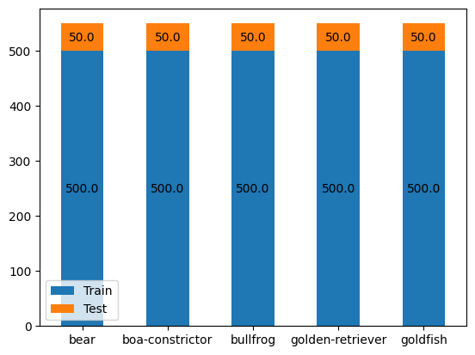
Question 3: Train the same model again, but now use one of the technique you mentioned to deal with unbalanced dataset. How does the performance metrics change? Explain

Slide 5
Question 4: What are the hyper-parameters for a neural network model? What segment of the dataset is used to find these hyper-parameters (train/test/valid)?
Hyperparameters are the variables which determine the network structure and variables which determine how the network will be trained.
For example:
Number of Hidden Layers and units
Learning Rate
Activation function
Number of epochs
Batch size
Network Weight Initialization
Dropout
[Hyperparameters are set before training]
Validation segment of the dataset is used to find these hyper-parameters.
[Here we get our validation segment from train set as we weren't given validation data segment]

Slide 6
Question 5: If your dataset is missing one of these segments, you need to create one by randomly splitting the train dataset. REMEMBER to set stratify=y in the train_test_split function. What does this parameter do?
The stratify parameter ensures to retain the same proportion of classes in the train and test sets that are found in the entire original dataset.
For example:
If the original dataset has target/label as [0,1,2] in the ratio, say, 40:30:30.
[ That is, for every 100 datasets, you can find 40, 30 and 30 observations of target 0,1 and 2 respectively.]
Now when you split this original using the train_test_split(x,y,test_size=0.1,stratify=y),
The method returns train and test datasets in the ratio of 90:10. Now in each of these datasets, the target/label data proportion is preserved as 40:30:30 for the classes [0,1,2].

Slide 7
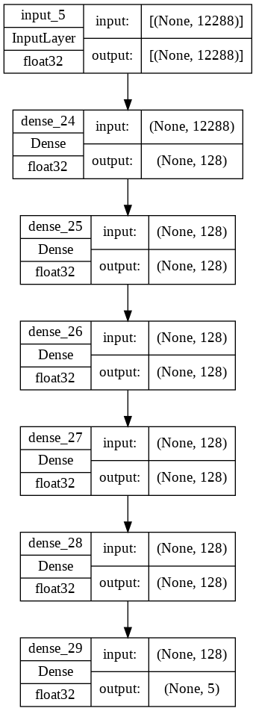
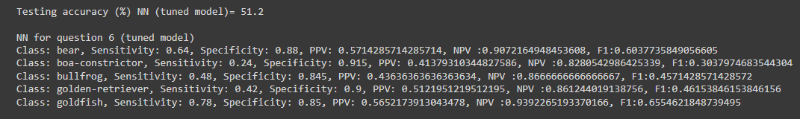
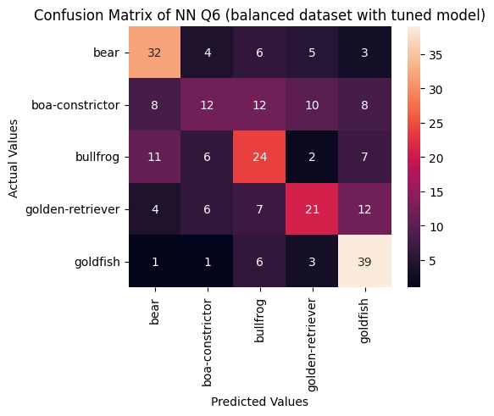
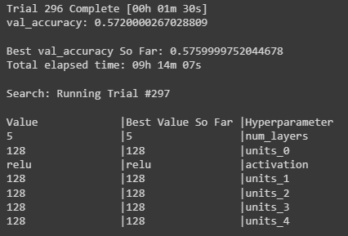
Question 6: Comparison the result of tuned model with result of previous model.

Slide 8


